Slide 1
Making Connections
Creating Linked Open Data
Neil Wilson
Head, Collection Metadata
UKSG Webinar
June 16 2016

Slide 2
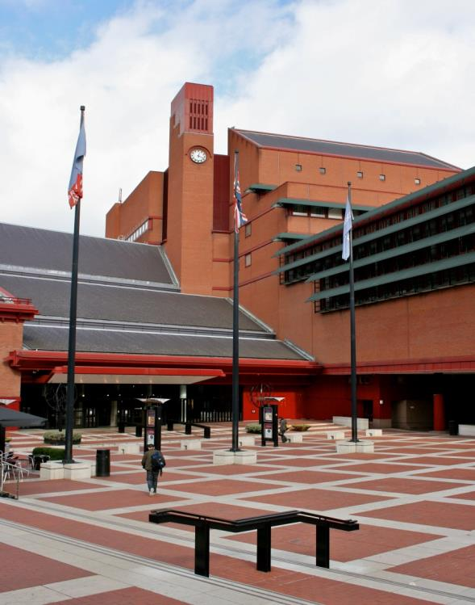
Objectives
To describe:
Why libraries offer linked data
What are the basic concepts
How might you create linked data

Slide 3
Why?
Linked Open Library Data

Slide 4
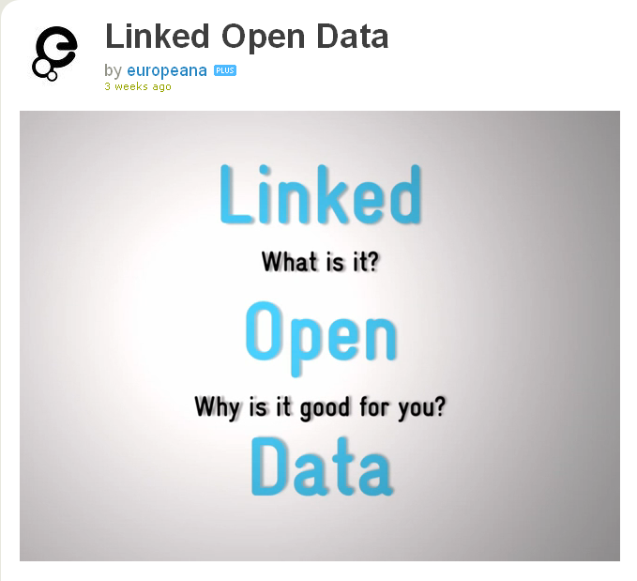
Why Linked Open Library Data?
Concept of open & connected information - fits well with libraries
Participation in the new landscape – improves access to knowledge & culture
The promise of a reusable global data pool – should enable libraries to add unique value
See: http://vimeo.com/36752317

Slide 5
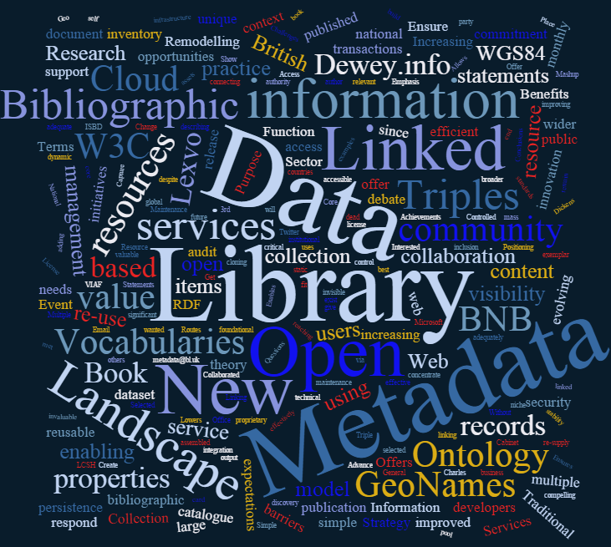
Potential For Practical Library Benefits
Cost effective way to make deep data visible to search engines
Valuable option for integrating disparate data
Useful for powering third party apps, web services & visualisations
Better return on investment via flexibility of store

Slide 6
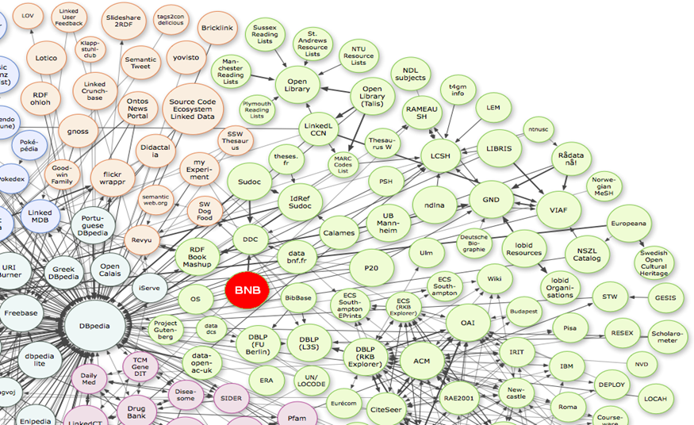
Potential User Benefits
Offers the ability to ask new types of question
Enables us to see new connections in previously disconnected data
Offers new research possibilities to generate new knowledge
Supports the creation & curation of virtual / distributed global collections
“Linking Open Data cloud diagram, by Richard Cyganiak and Anja Jentzsch. http://lod-cloud.net/”

Slide 7
Pros & Cons?
Advantages:
  Flexibility
  Search engine exposure
  Fresh approach
  Inferencing
Issues:
  Trust?
  Privacy?
  Persistence?
  Learning curve?
  A work in progress…

Slide 8
What?
Linked Open Library Data

Slide 9
Linked / Open Data?
Open Data – can exist without linking
Linked Data – can exist without being open
Linked Open Data – is open data designed to support linking to other open data resources
Both – can be offered as file dumps and/or live services
See: http://www.semantic-web.at/LOD-TheEssentials.pdf
Linked Open Data

Slide 10
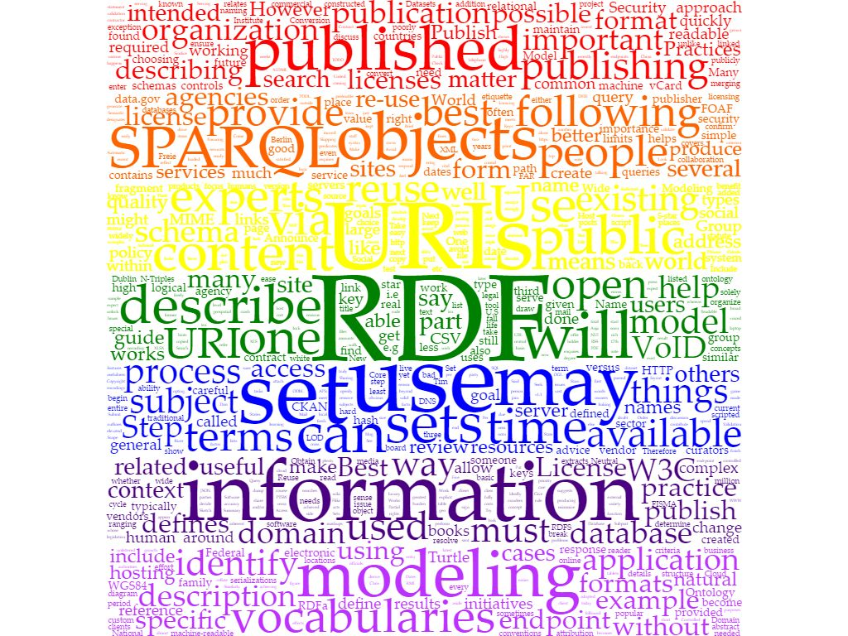
Best Practices for Producing Linked Data
Model the Data
Name things with URIs
Re-use vocabularies if possible
Publish human & machine readable descriptions
Convert data to RDF
Specify an appropriate license
Host publicly & publicise
See: https://www.w3.org/2011/gld/wiki/Linked_Data_Cookbook

Slide 11
Linked & Library Data
Traditional library data uses static, proprietary document based, table driven database models
Linked Data uses a dynamic data based ‘graph’ model, linking simple 3 part statements describing resource characteristics
  Traditional
  Passive
  Self-contained
  End Result
  Domain Specific Standards
Linked
Dynamic / Interactive
Linked to External Resources
Options for Further Inquiry
Open Structure & Standards

Slide 12
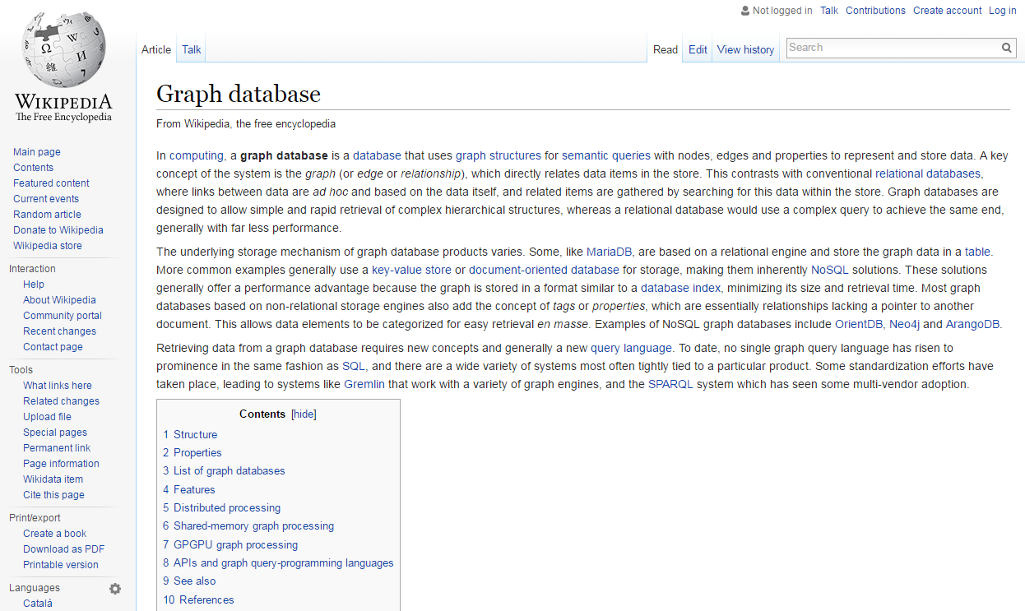
Linked Data Concepts
Graph Database Model
Differs from traditional table based relational databases
Enables representation of resource relationships
Supports rapid navigation of complex linked data structures
Without complexity of relational database table queries
See: http://vimeo.com/36752317

Slide 13
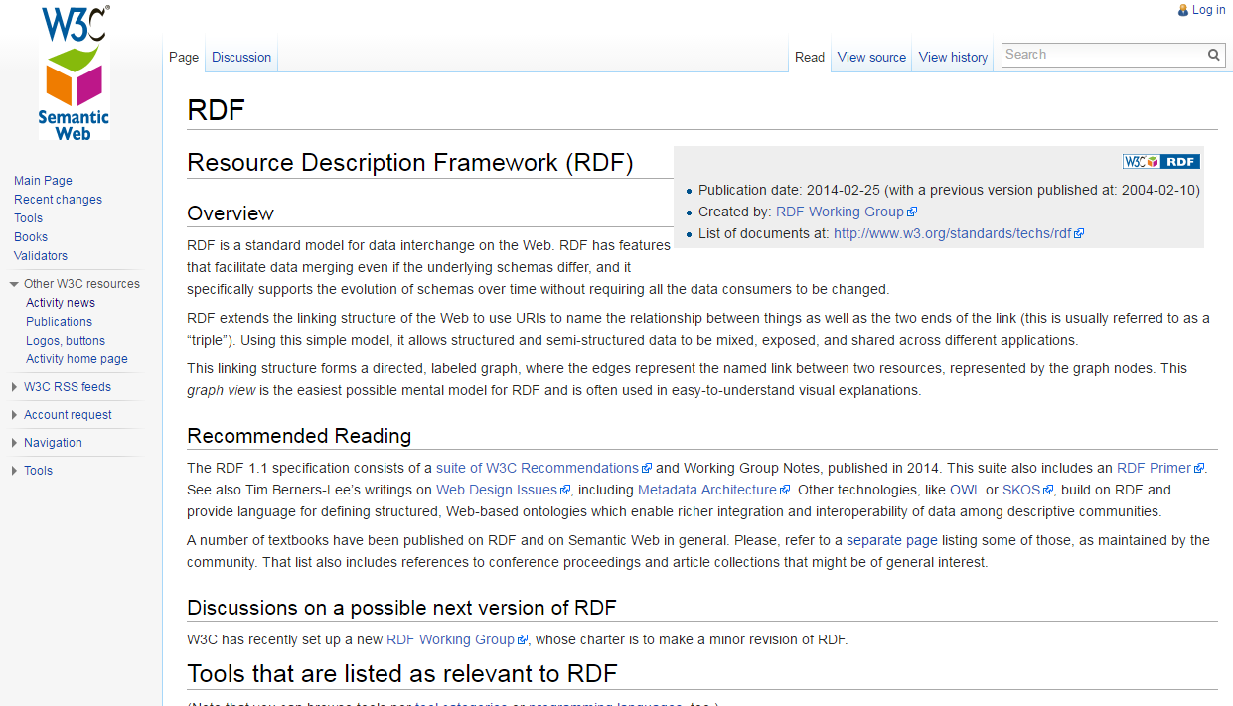
Linked Data Concepts
Resource Description Framework (RDF)
A family of W3C specifications
Data model used for representing resources for the Web
Based around entity relationships
Serialised in a variety of formats, including XML

Slide 14
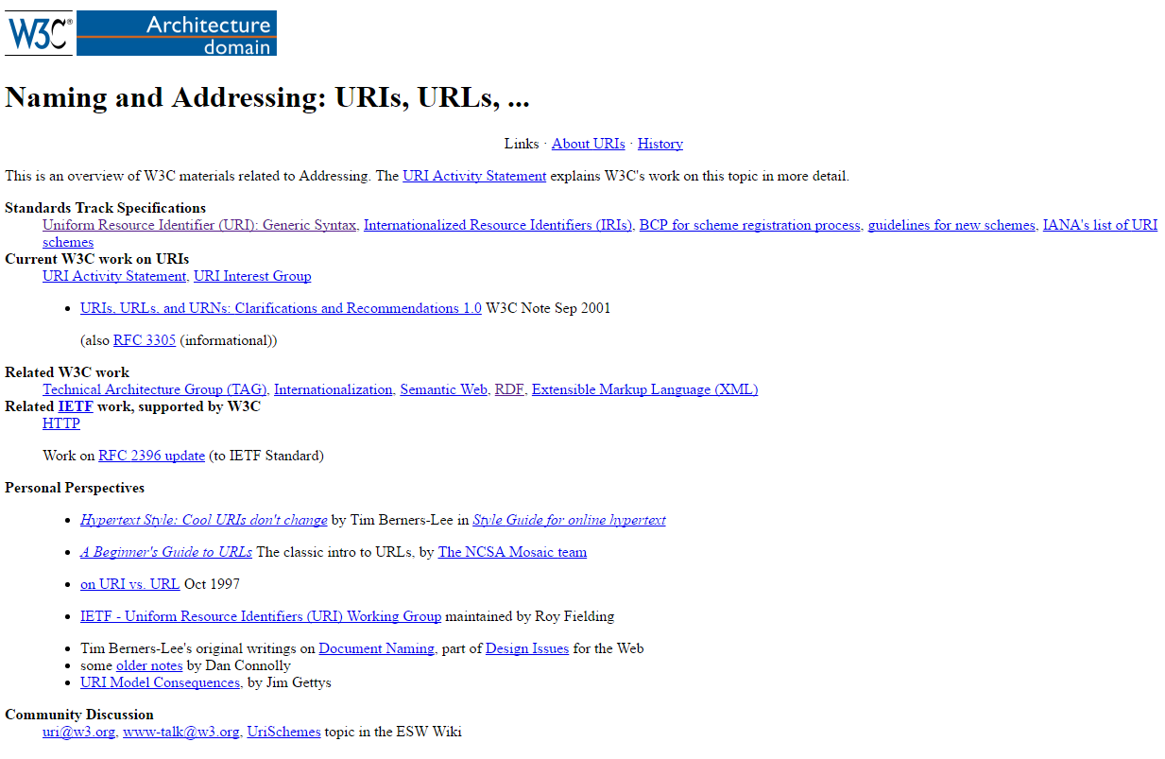
Linked Data Concepts
Resource Identifiers URIs/IRIs
Use of ‘Uniform Resource Identifiers’ (URIs) - for linking to other resources
Replacement of literal values -with persistent URIs
Can be:
  Your own or pre-existing
  Opaque or transparent
  But should be valid, i.e. syntax conformant URIs
  (See: https://www.ietf.org/rfc/rfc3986.txt )
See: http://vimeo.com/36752317

Slide 15
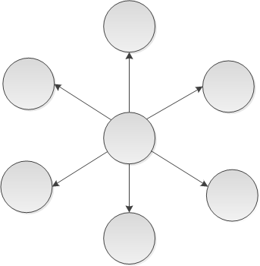
New Resource Descriptions
Great Expectations
Dickens, Charles
1812-1870
570p
Title
Pagination
Author
Resource
Publisher
Subject
Penguin English Library
ISBN
England - Social conditions - Fiction
9780141198897

Slide 16
Remodelling The Data
Replace Text with Links

Slide 17
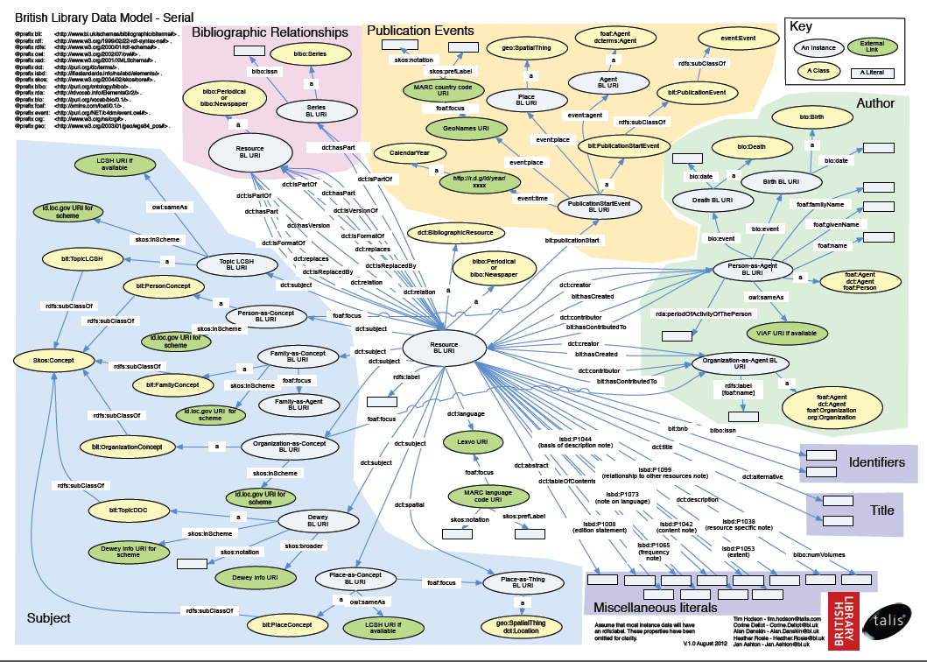
MARC21 Remodelled to RDF

Slide 18
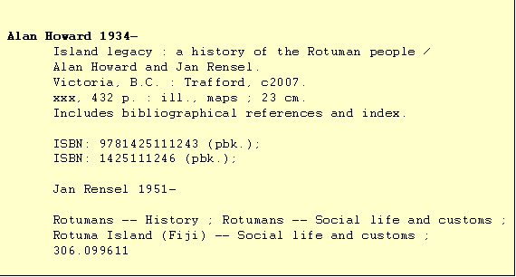
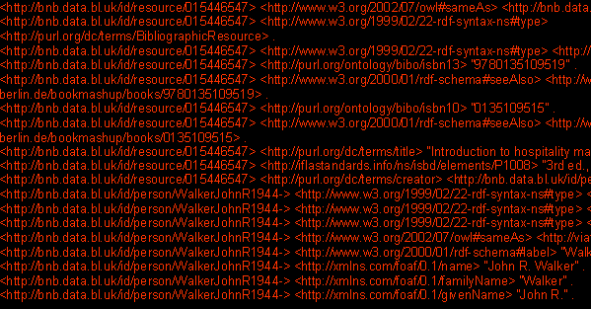
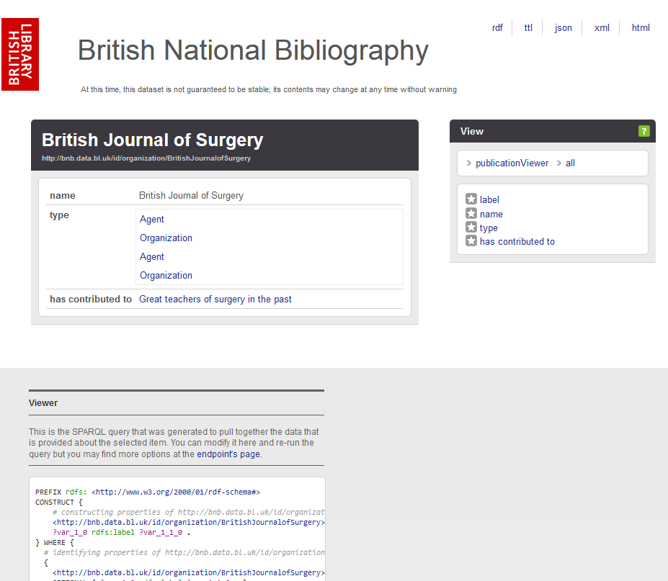
A Change in Emphasis
From self contained records describing bibliographic resources
To simple statements about such resources (e.g. [This book] [has the author] [Charles Dickens])
With ‘records’ assembled from connected statements

Slide 19
How?
Linked Open Library Data

Slide 20
RDF Vocabularies
RDF/RDF Schema/ OWL...
Bibliographic Resource
  Dublin Core
  Bibliographic Ontology
  ISBD
  British Library Terms
Event
  Event Ontology
  British Library Terms
Person/Organization
  FOAF: Friend of a Friend
  Bio: a Vocabulary for Biographical Information
  Org: an Organisation Ontology
  RDA
  MADS/RDF
Place
  WGS84 Geo Positioning
Concept
  SKOS
  British Library Terms

Slide 21
The Data Model - Publication as Event
@prefix dc:<http://purl.org/dc/elements/1.1/> .
@prefix dcterms:<http://purl.org/dc/terms> .
<BibResource> dc:publisher “Publisher” ;
dcterms:issued “Date” ;
?:placeOfPublication “Place” .
@prefix blt:<http://www.bl.uk/schemas/bibliographic/blterms#> .
@prefix event:<http://purl.org/NET/c4dm/event.owl#> .
<BibResource> blt:publication <PublicationEvent> .
<PublicationEvent> event:place <Place> ;
event:agent <Publisher> ;
event:time <Year> .
Usual approach
Event-based approach

Slide 22
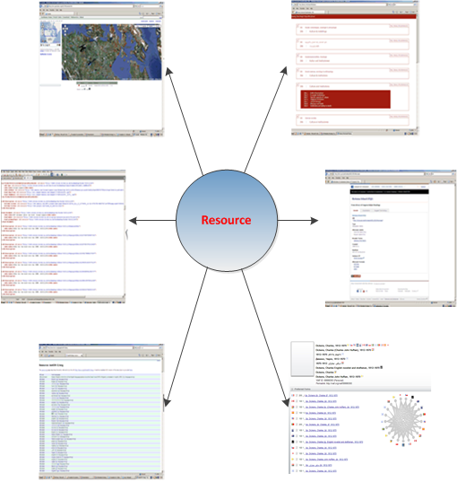
Links to External Resources
To give data wider context we linked to:
General resources e.g.
        GeoNames
        Lexvo
        ISNI
Library resources e.g.
        LCSH
        VIAF
        Dewey.info

Slide 23
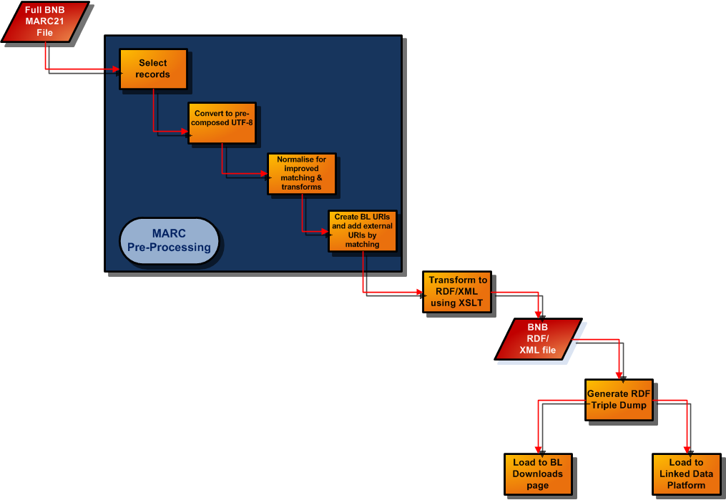
MARC21 to RDF Pipeline
Process
Selection
Character set conversion
Pre-processing
URI generation
Data transformation
Create & load triples
Produce VoID descriptions
Tools
Catalogue Bridge Utilities
MARC Global/MARC Report
http://www.marcofquality.com/
Jena Eyeball
http://jena.sourceforge.net/Eyeball/

Slide 24
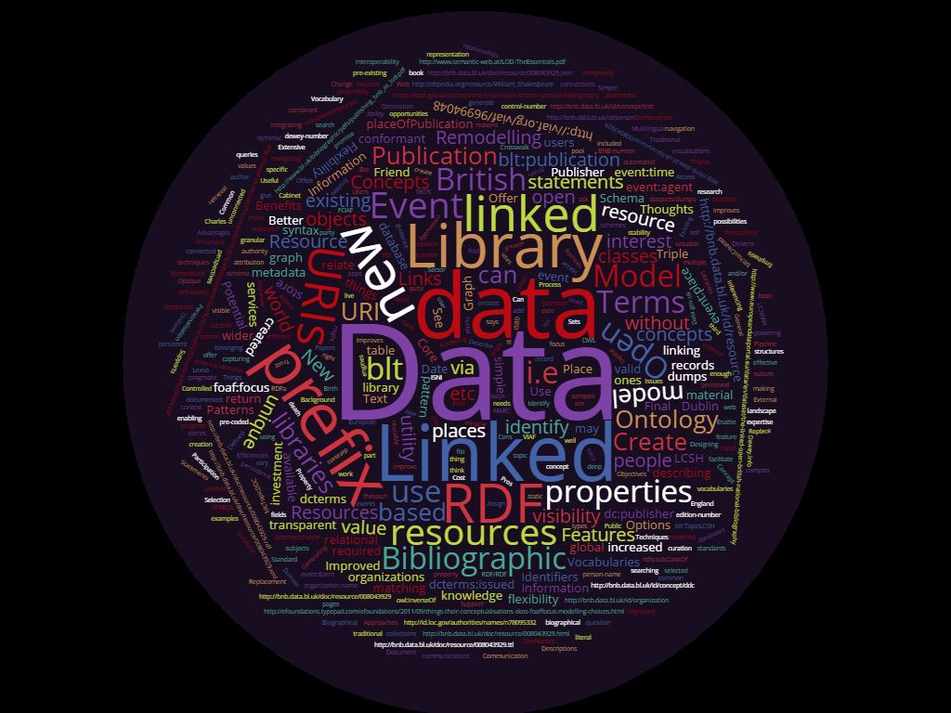
Multiple Publication Options
Linked data can be offered via multiple routes:
  SPARQL endpoint
  RDF triple data dumps
  Web pages using RDFa & content negotiation
And in multiple formats including:
  Turtle (TTL)
  RDF XML
  JSON LD etc.

Slide 25
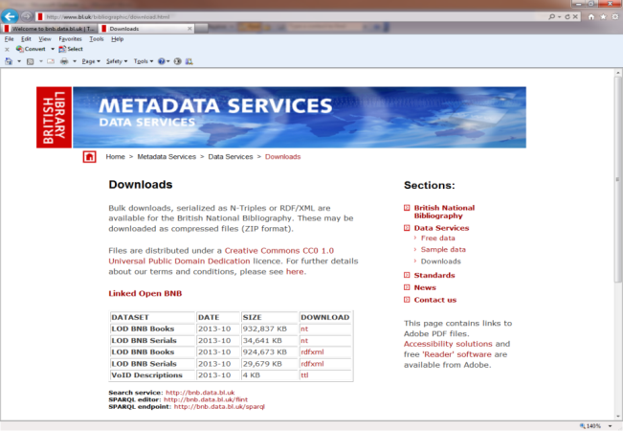
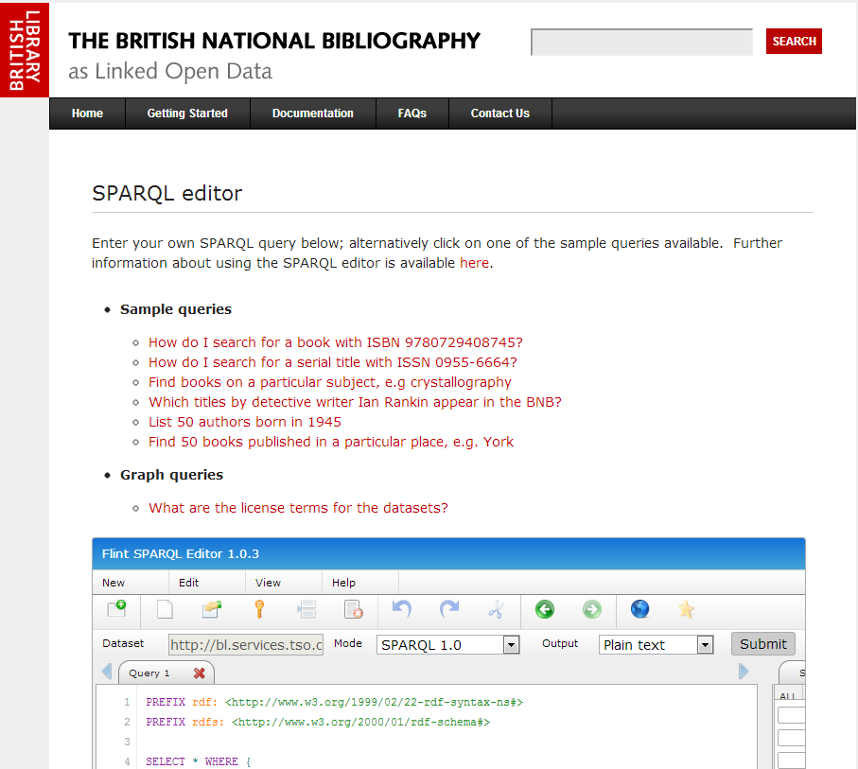
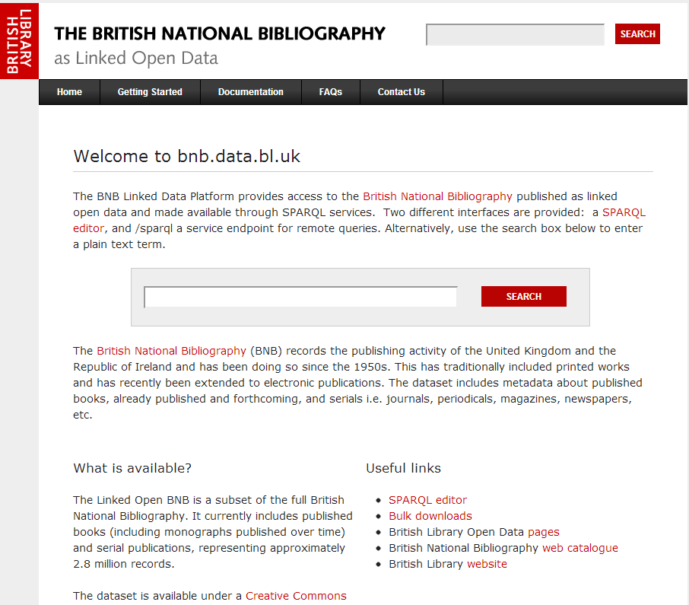
BNB Access Options
www.bl.uk/bibliographic/download.html
BNB 1950-2016
3.1 Million Records
105 Million Unique Triples
with VoID descriptions & multiple serialisations
Updated Monthly
.
bnb.data.bl.uk/sparql
bnb.data.bl.uk

Slide 26
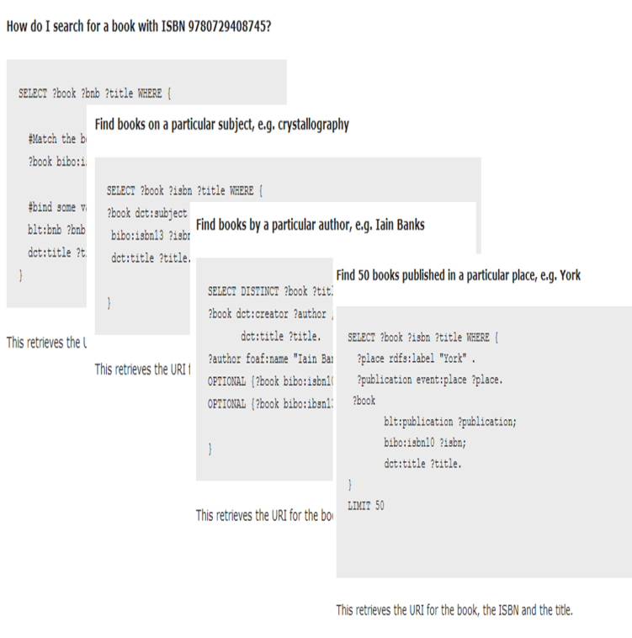
Communication
New users = new communications - expertise & abilities vary
Demonstrate use by practical examples
Document your data – identify entities (places, people, dates etc.)
Offer samples – identify user needs & continually improve

Slide 27
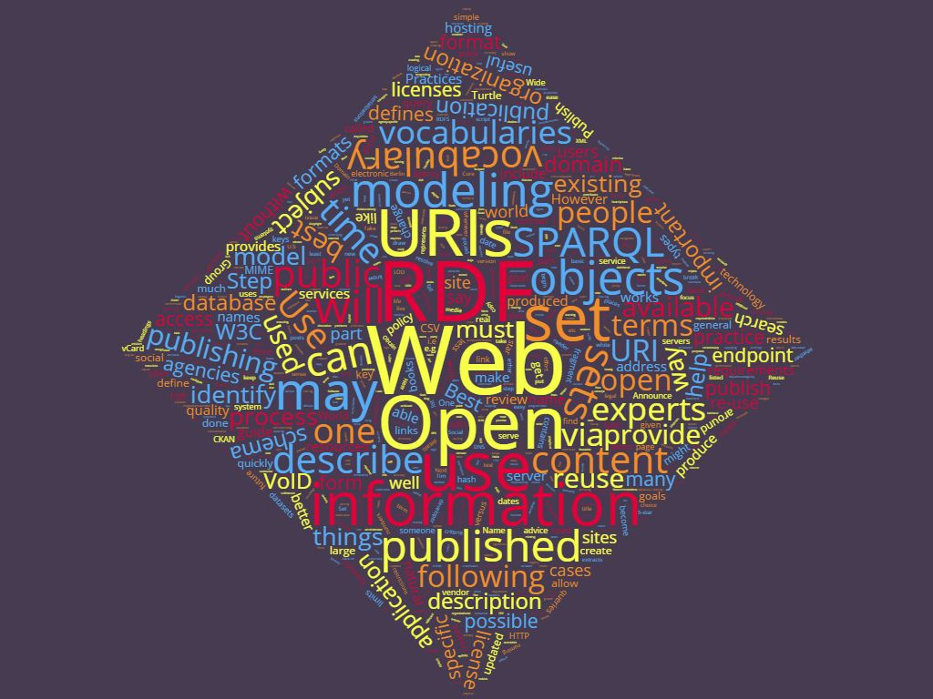
Some Final Thoughts
Linked Library Data:
Improves library visibility to new users - wider utility = greater relevance & perceived value
Need to find new ways of capturing value & attribution
Offers libraries new opportunities – via their authority, persistence & stability
Isn’t a ‘miracle cure’ – but can be a valuable tool

Slide 28
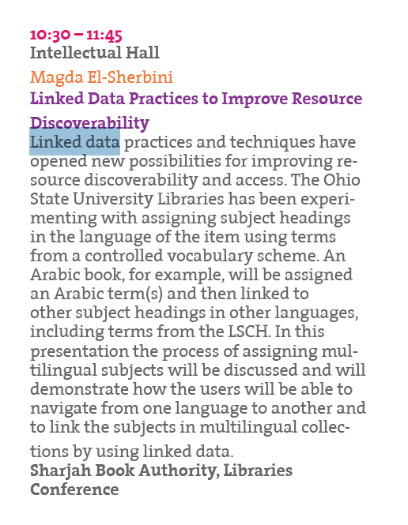
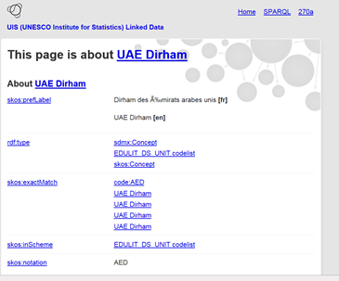
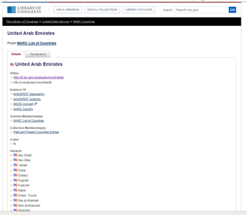
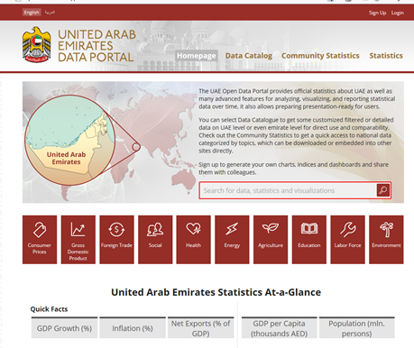
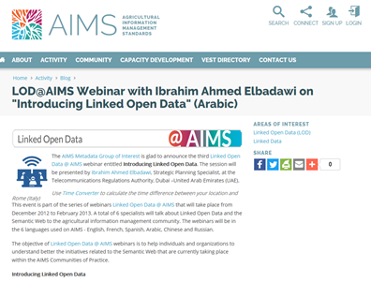
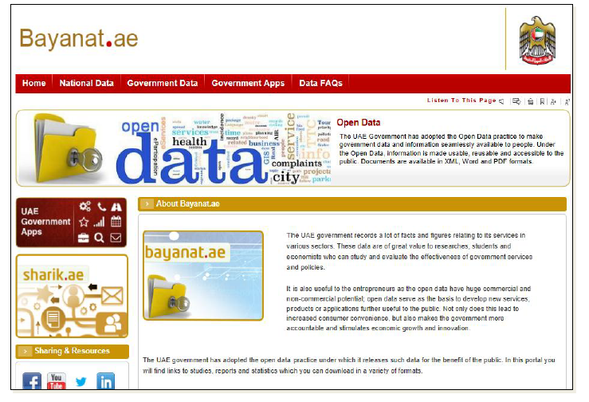
Linked / Open Data in the UAE

Slide 29
Background Resources
Linked Data & RDF
Best practices for publishing linked data http://www.w3.org/TR/ld-bp/ http://linkeddatabook.com/editions/1.0/
Semantic Web standards http://www.w3.org/standards/semanticweb/data.html
RDF 1.1 Primer https://www.w3.org/TR/rdf11-primer/
LD4PE Linked Data Exploratorium (A Work in Progress) http://explore.dublincore.net/linked-data-learning-resources/
BNB
Data.gov.uk https://data.gov.uk/dataset/the-linked-open-british-national-bibliography
Papers: http://www.bl.uk/bibliographic/pdfs/publishing_bnb_as_lod.pdf http://research.microsoft.com/pubs/193076/Whitepaper%20on%20Linking%20Structured%20Data.pdf

Slide 30
For More Information Visit… http://www.bl.uk/bibliographic/datafree.html http://bnb.data.bl.uk/faqs http://bnb.data.bl.uk/getting-started http://bnb.data.bl.uk/docs
http://twitter.com/#!/BLMetadata
metadata@bl.uk
http://www.bl.uk/bibliographic/datafree.html

Slide 31
Questions?
Linked Open Library Data

